Slide 1
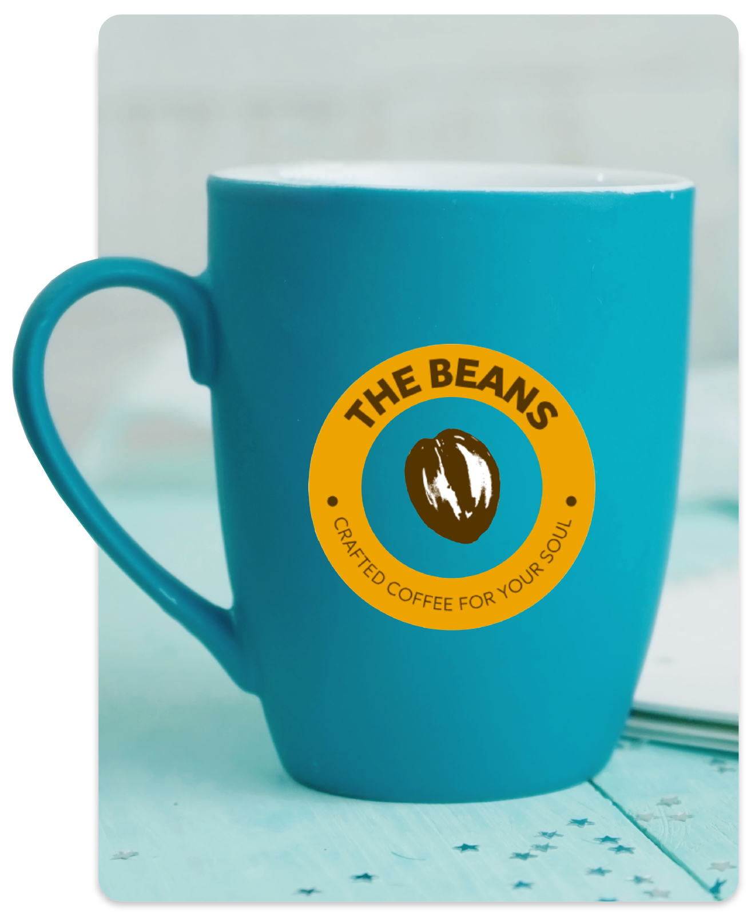
Hostopia Connects
01 Cover
Professional Logo Design
Build a brand customers recognize, trust, and remember.
A sales presentation for service providers — ready to rebrand with your own identity.

Slide 2
Hostopia Connects
02 Agenda
What we'll cover.
Twenty-five minutes, five sections. Most of the value lives in section five.
Why logos matter now
The 2025 data on first impressions and brand trust.
The product
What it is, who it's for, and what's included.
The creative process
From brief to final files in 2–3 weeks.
Plans

Slide 3
Hostopia Connects
03 Why it matters
Why logos matter
The time consumers take to form a first impression of a business.
A professional logo is the strongest visual signal that shapes that impression — and the brain decides whether to trust a business in that window.
Recognition lift
Brand recognition lift from a well-designed logo.
Trust boost
Trust boost prospects feel after seeing a polished logo.
Impression weight
Share of first-impression weight driven by logo color alone.

Slide 4
Hostopia Connects
04 Whats at stake
What's at stake
The cost of a weak or missing logo.
Cost 01
Lost credibility
A logo makes a business look established. Without one, prospects default to whichever competitor looks more professional.
Cost 02
Missed differentiation
Logos are how customers tell one business from another. A generic or absent mark means customers can't find you.
Cost 03

Slide 5
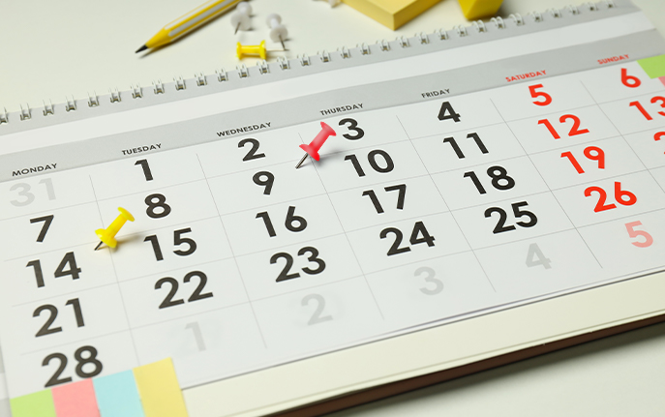
Hostopia Connects
05 The product
What makes it different.
Four product fundamentals that separate Professional Logo Design from free tools, freelancers, and AI generators.
People, not prompts.
Ten-plus years of experience and 75,000+ logos delivered. By 2025, 20% of all logos are AI-generated — which makes human-designed marks more differentiated, not less.
The customer owns the mark outright.
Trademark-able. Royalty-free. A formal rights-transfer letter is included with every project. Free logo tools rarely transfer full rights.
Ready for every application.
AI, EPS, PDF, JPG, PNG, GIF, and ICO — six color versions and five black-and-white. Web, print, merchandise, social, signage.
Initial concepts in three to five business days.

Slide 6
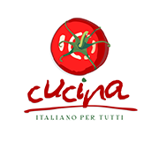
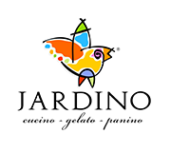
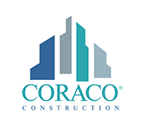
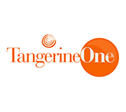
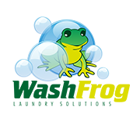
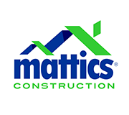
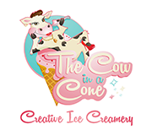
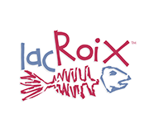

Hostopia Connects
06 Selected work
A few of the brands we've built.
Logos delivered
Verticals

Slide 7

Hostopia Connects
07 The process
The creative process
From brief to final files.
Purchase & welcome
Customer purchases a plan and receives a welcome email confirming the order.
Coordinator outreach
A dedicated Logo Design Coordinator collects the creative brief — goals, style, colors, references.
Initial concepts
In-house designers deliver up to ten custom concepts based on the brief.
Revisions

Slide 8
Hostopia Connects
08 Plans
Three tiers for every budget.
All plans include the Logo Design Coordinator, three rounds of revisions, the 11-format file package, and full ownership of the final design.
Logo Design Coordinator
4 custom design concepts
3 rounds of revisions
11 final file formats
Full ownership of design
Everything in Bronze
6 custom design concepts
Business card design
Letterhead & envelope
Stationery rights included
Everything in Silver
10 custom design concepts
1,000 printed business cards
Branded email signature
Premium support

Slide 9
Hostopia Connects
09 Discovery
Questions to ask on the call.
Seven questions, in order. The first opens every conversation. The last closes most of them.

Slide 10
Hostopia Connects
10 Objections
Objection handling
The top five concerns — and how to answer them.

Slide 11
Hostopia Connects
11 Competitive
Competitive positioning
Why we win.
Four categories. One sentence each. Use the matching row when a prospect names a specific competitor.
Headline
Human-designed originality, full rights transfer, 11 file formats. Free tools typically offer limited originality, partial rights, and fewer formats.
A dedicated coordinator and an in-house team that's delivered 75,000+ logos — not a stranger juggling thirty concurrent projects. Predictable turnaround.
Comparable quality at a fraction of the cost, with a defined scope and timeline. No surprise invoices, no scope creep, no six-month engagements.
20% of 2025 logos are AI-generated, which means they increasingly look alike. Human-designed marks remain more differentiated — and more defensible as trademarks.

Slide 12
Hostopia Connects
12 FAQ
FAQs
The questions customers ask most.
How many revisions are included?
Up to three rounds in every plan. Additional revisions are available for an extra fee.
How long does it take?
Concepts arrive in three to five business days. Full projects typically complete in two to three weeks.
What file formats do I receive?
Eleven formats — AI, EPS, PDF, JPG, PNG, GIF, and ICO. Six color, five black-and-white.
Who owns the finished logo?

Slide 13
Hostopia Connects
13 Get started
Have questions, want to schedule a demo, or explore how these solutions can support your sales teams today?
Contact us at marketing@hostopia.com to learn more and connect with one of our experts.

